Slide 1
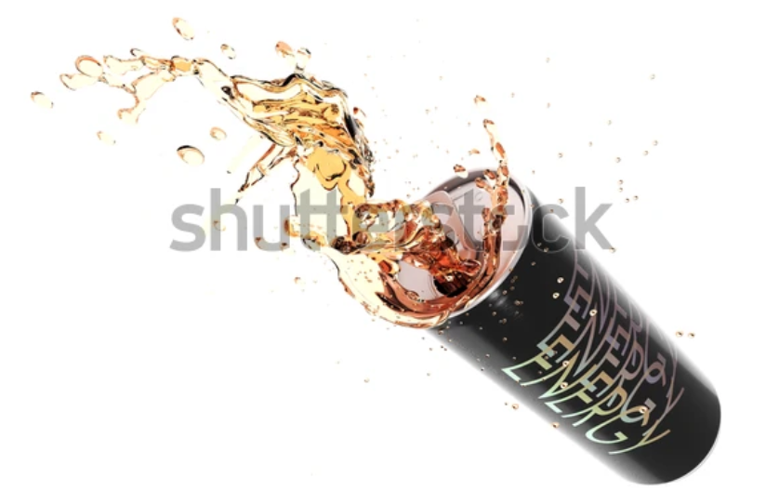
Documented Report Of Data Analysis Project Python

Slide 2
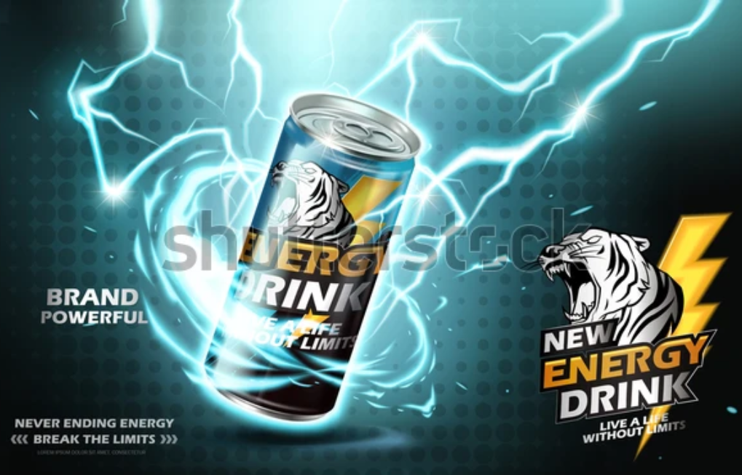
Problem Statement
A Food and Beverage Company has recently introduced a new energy drink named CodeX into the market.
To ensure the success of CodeX, the marketing team requires comprehensive insights through data analysis to understand the performance, consumer preferences, and market dynamics associated with the product.

Slide 3
Data Collection
In this data analysis project focused on the marketing performance of the CodeX energy drink, the data collection phase involved obtaining relevant information from online sources.
The collected data is stored in three CSV (Comma-Separated Values) files dim_respondents (providing respondent details), dim_cities (containing city information), and fact_survey_responses (comprising market and survey data). These files were subsequently uploaded and manipulated using the pandas library in Python for further analysis and visualization.

Slide 4
Main Challenges
Dominance of Object-Based Data: Hindered the application of traditional numerical analytical methods, requiring alternative approaches.
Interpreting Inconclusive Results: Relying on count-based analysis proved challenging, especially when results were evenly distributed, which required careful interpretation and further exploration

Slide 5
Objectives
Consumer Behavior Analysis:Understand consumer preferences and behavior related to energy drinks. Identify factors influencing the purchase decision of CodeX
Market Penetration Assessment:Identify potential market segments and target demographics for CodeX
Product Performance Metrics:Assess the sales performance of CodeX in various regions and channels
Brand Perception and Positioning: Analyze consumer feedback and reviews to gauge brand perception. Determine the positioning of CodeX in comparison to competitors
Marketing Channel Effectiveness:Optimize marketing strategies based on channel performance
Price Sensitivity Analysis:Identify optimal price points to maximize sales and profitability

Slide 6


Exploratory Data Analysis

Slide 7
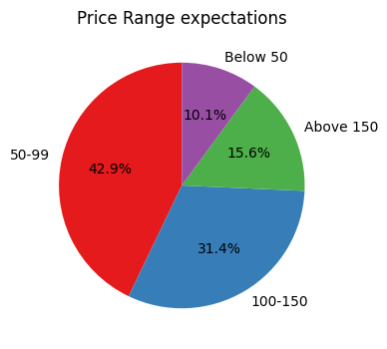
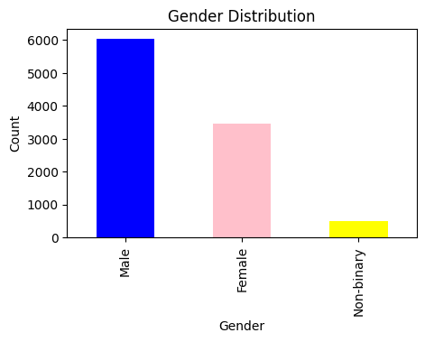
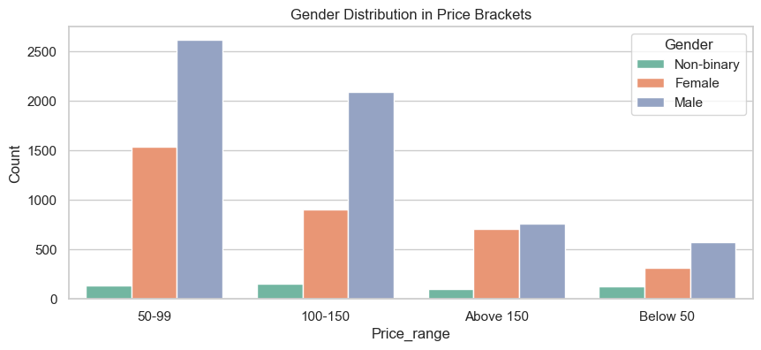
Gender Analysis: Order Distribution and Purchasing Power
The gender distribution shows that most of the people consuming energy drinks are males
The Gender distribution in price range also shows that the purchasing power of males is higher
The pie chart shows most of the people (around 75%) are capable of spending more than 50 but don’t expect it to be priced more than 150
Recommendations
Optimize pricing strategy within the range of 50-150
Focus marketing efforts that specifically appeal to the preferences and purchasing behaviors of the male demographic.
Optimize marketing channels preferred by males to maximize visibility and engagement.
While focusing on the male demographic, ensure that marketing strategies remain inclusive.

Slide 8
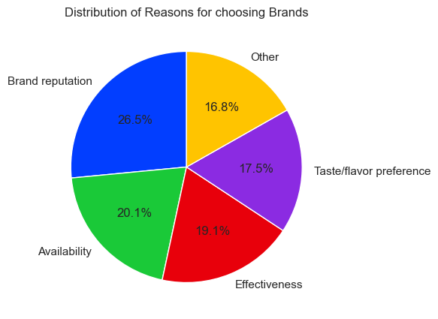
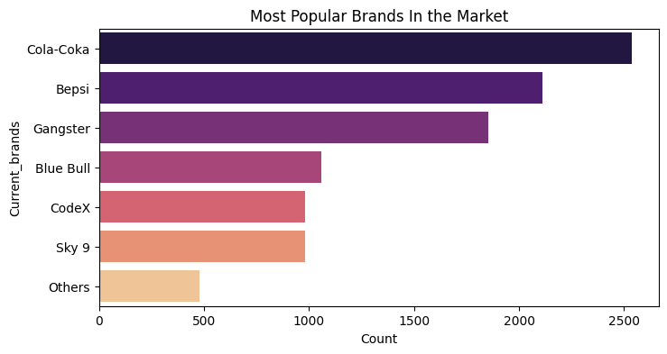
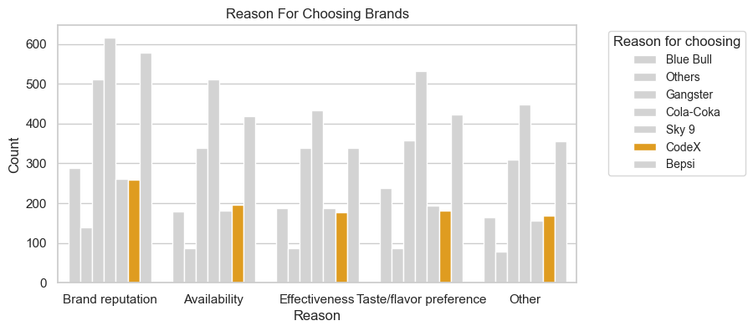
Consumer Preferences and Market Positioning Analysis
From the horizontal bar plot we observe that Cola-Coka and Bepsi are the most popular brands, it shows position of our brand CodeX
The Pie chart shows a balanced distribution of reasons for choosing brands
The grouped bar plot shows our energy drink brand's position among its competitors, as we see our brand in comparison with other brands on the basis of 5 different reasons
Recommendations
Emphasize unique selling points that distinguish your energy drink brand from competitors like highlighting specific ingredients, flavor profiles, or health benefits that set it apart.
Creating brand narratives that can establish an emotional connection with consumers
Analysis of competitors which are most popular brands in the market like Cola-Coka and Bepsi

Slide 9
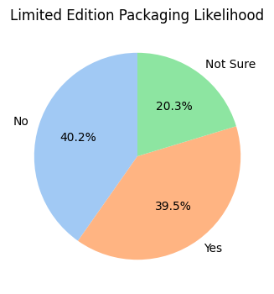
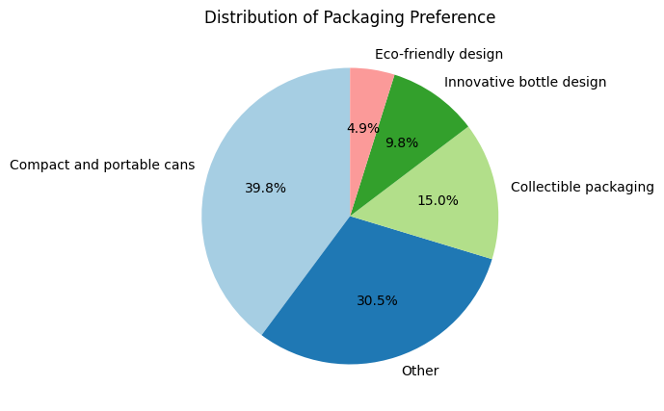
Packaging Preference Analysis
In the above pie chart we can see that while around 40% of the people found limited edition packaging impactful, an equivalent percentage did not perceive any substantial impact, reflecting a balanced distribution of responses
The second pie chart shows that people prefer compact and portable cans and find them convenient
Recommendations
Strategically introduce limited edition packaging to capitalize on the 40% who find it impactful.
Enhance canned packaging features and sustainability, aligning with the 40% preference, while exploring opportunities for innovative designs in other packaging types

Slide 10
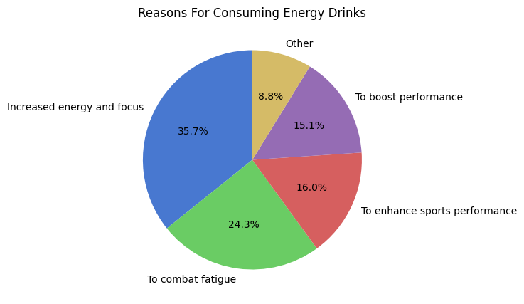
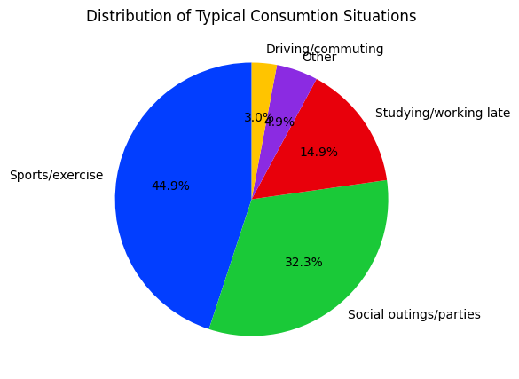
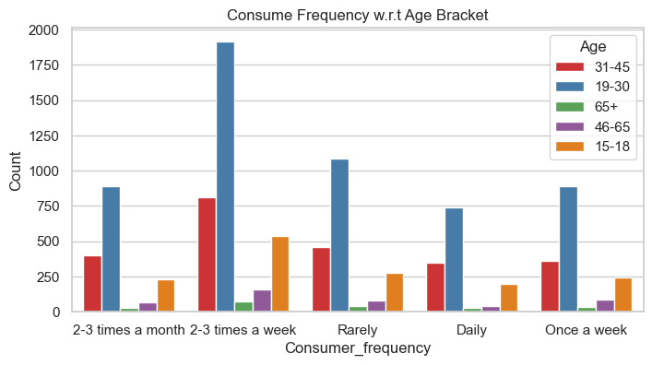
Consumer Behavior
The first pie chart shows most of the people consume energy drinks for energy, focus and to combat fatigue
The second pie chart shows that sports/exercise and Social outings are the situation where people most likely consume these drinks
The grouped bar plot shows the consumer frequency of various age groups, people aged 15-45 consume the most with 19-30 age group being most frequent.

Slide 11
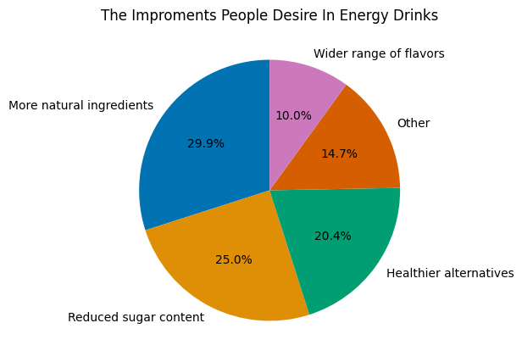
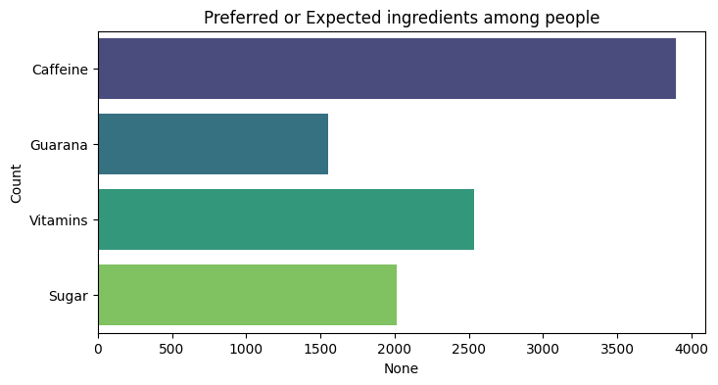
Consumer Behavior
The pie chart shows that, about one-third people want more natural ingredients whereas one-fourth would like reduced sugar content
The bar plot shows that Caffeine is the most preferred ingredient in energy drink among people

Slide 12
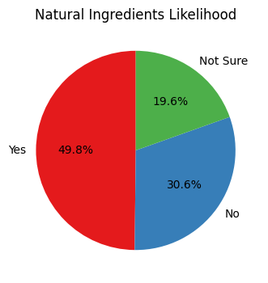
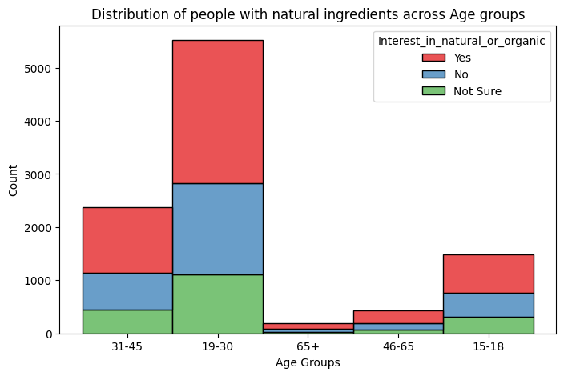
Consumer Behavior
The pie chart shows almost half of the people look for natural or organic ingredients in their energy drinks
In the stacked bar plot also, we observe that almost 50% in every age bracket show interest in natural or organic ingredients in their energy drinks
Recommendations
Emphasize the benefits of energy, combating fatigue and focus in marketing, to target the primary consumption situations of sports, exercise, social outings, and parties.
Focus marketing initiative on 19-31 age group
Prioritize formulations with natural ingredients, particularly emphasizing caffeine and vitamins.
Address the 25% seeking reduced sugar content by offering low-sugar variants

Slide 13
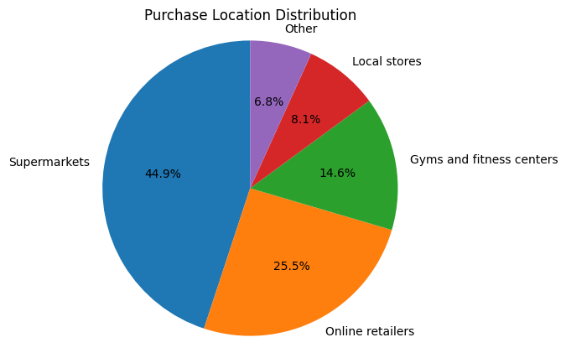
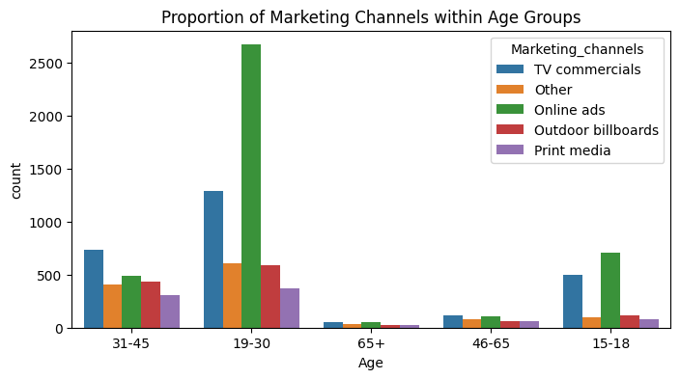
Sales Distribution Channels and Marketing Effectiveness
The pie chart shows that Online retailers and Supermarkets are the primary distributors of energy drinks, accounting for the majority of sales in this category
The grouped bar plot we can say that among the youth, Online ads and TV commercials are the most impactful marketing channels
Recommendations
Enhance supermarket presence by promotional campaigns within supermarkets to boost visibility and sales.
Invest in online marketing, leverage digital platforms like social media to target online retail sales segment

Slide 14
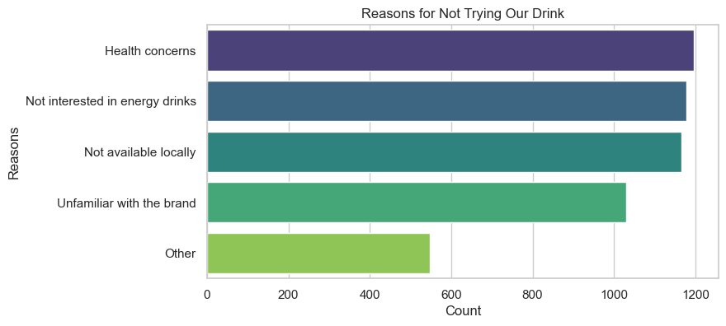
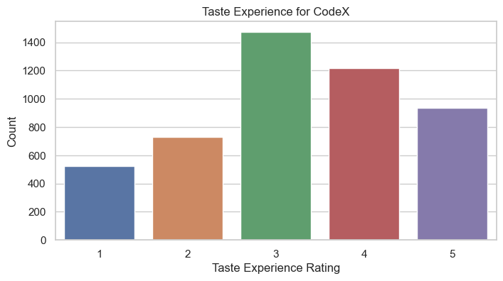
Consumer Preferences and Taste Perception
The Horizontal bar plot shows that, most of the people say health concern and lack of interest in energy drinks as the primary reasons for not consuming the energy drink
The bar plot below shows the taste experience rating 1 to 5, for our energy drink CodeX. Most of the people rate it 3, overall the average taste experience is 3.26
Recommendations
Develop marketing campaigns emphasizing the health benefits or nutritional aspects of CodeX
Consider consumer feedback and aim for taste enhancements to elevate the overall rating and appeal to a broader audience.

Slide 15
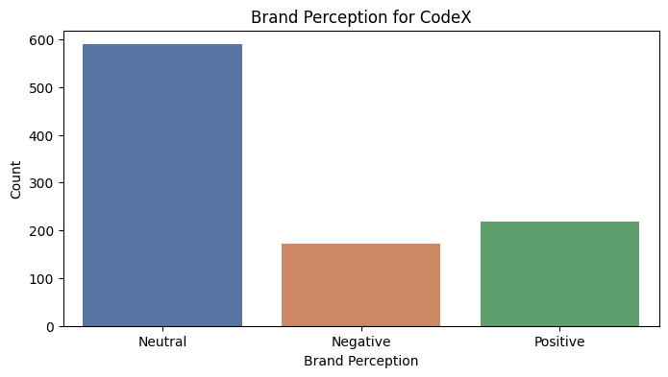
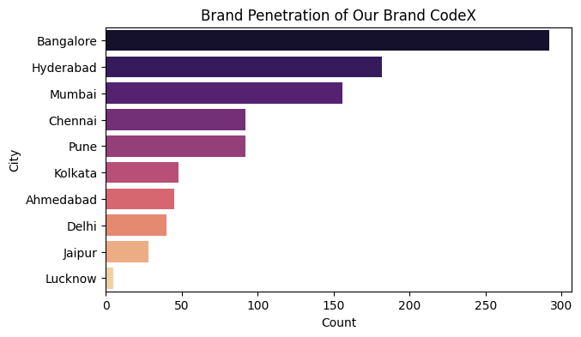
Geographical Brand Penetration and Perception Analysis
The bar plot shows that most of the people have neutral perception for our brand
From the Horizontal bar plot we observe Lucknow, Jaipur, Delhi, Ahmedabad and Kolkata are the cities where brand penetration seems comparatively low
Recommendations
Implement targeted marketing campaigns in Lucknow, Jaipur, Delhi, Ahmedabad, and Kolkata to increase brand awareness.
Invest in brand perception improvement strategies, including consumer engagement, product promotions, and communication efforts to shift the neutral perception towards a more positive sentiment.

Slide 16
Conclusion
The findings reveal that males are predominant consumers of energy drinks, and the age group of 19-31 years exhibits the highest frequency of consumption.
Supermarkets and online retailers emerge as the preferred purchase points for these beverages, highlighting the convenience and accessibility factors.
Analysis indicates that online ads and TV commercials play a significant role in influencing the youth, making them effective marketing channels.
Preferences for caffeine and vitamin-based drinks, along with a preference for canned packaging, underline the importance of portability and health-conscious choices among consumers.
The average rating of 3.26 for our energy drink suggests a moderately positive reception, encouraging us to further enhance and refine our product.
Cities like Lucknow, Jaipur, Delhi, Ahmedabad, and Kolkata show low brand penetration, suggesting potential areas for targeted marketing and expansion.
Understanding that sports, exercise, and social outings constitute the typical consumption situations for 75% of individuals, we can tailor marketing strategies to align with these scenarios. Moreover, the majority of consumers expect energy drink prices to fall between 50 to 150 Rupees, indicating a price sensitivity that should be considered in pricing strategies.
Lastly, the notable preference for natural ingredients among 50% of consumers signals a growing demand for healthier formulations. This insight can guide product development efforts to cater to the evolving preferences of the market.

